Slide 1


Digital-haptic city model for information transfer using XR/AR
Notes:
Hi, I'm Chris from Vision IO.

Slide 2

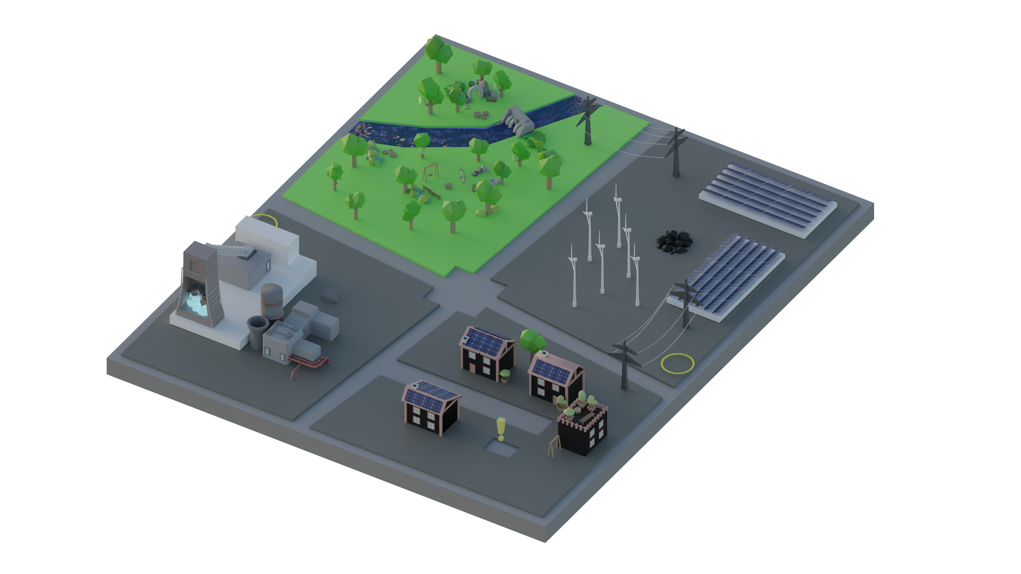
What is Vision.IO?
Vision.IO, a digital-haptic city model for information transfer through XR/AR showcases the potential of merging augmented reality with physical interactions. This immersive experience transforms augmented reality into extended reality, offering an innovative way to perceive and interact with urban environments.
Notes:
We have developed a digital-haptic city model for information transfer using augmented reality.
Augmented reality is a technology that places digital information over the real world to create an enhanced, immersive experience.
We have extended this immersive experience by adding physical interactions, transforming augmented reality into extended reality.
This creates the opportunity to present information in a new, innovative way,
as it is not only displayed visually, but can also be experienced through physical interactions.
In our city model, we show how different sectors affect the environment and how the environmental impact could be improved through the use of new technologies.

Slide 3

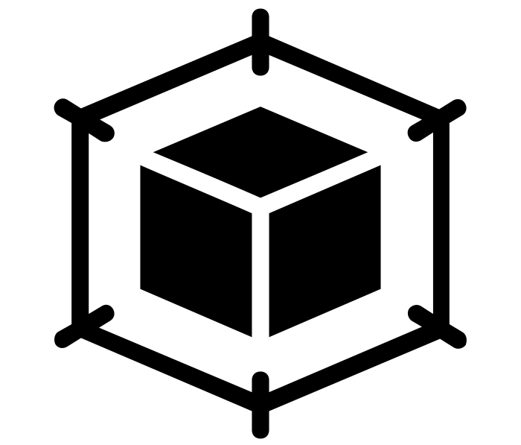
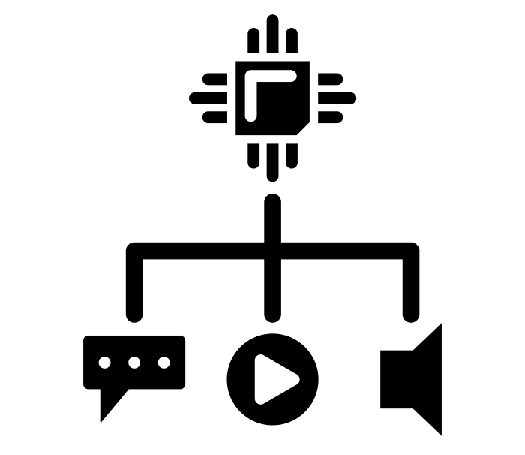
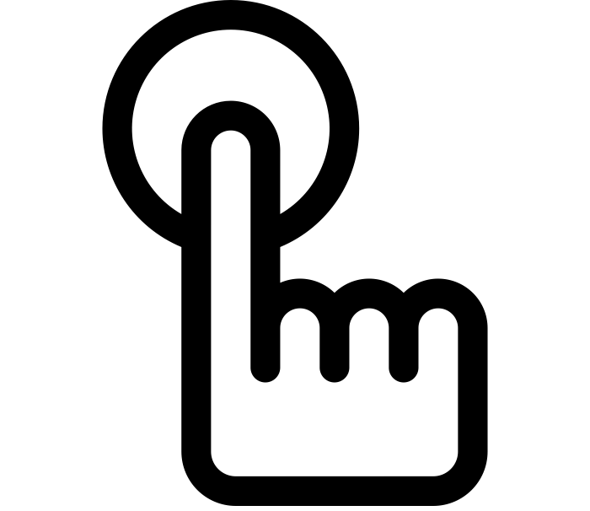
Requirements
Narrative
Model
Communication
Interactions
What information do we want to present with the city model?
What should the city model look like?
How does the virtual city model know which haptic interactions have been triggered?
Which physical Interactions should be used?
Notes:
The requirements for this project were:
Finding a narrative that we could use to build the city model.
Creating a city model that fits our narrative.
Finding out how our visualization hardware, would be informed by the haptic interactions.
Thinking about which haptic interactions to use and how the interactions would affect the virtual model.

Slide 4
Narrative & Model
Environmental Impact of different Sectors
Energy
Industry
Housing
Nature
Physical Model for interactions
Digital Model for visualization
Notes:
The result is a city model with four sectors: housing, energy, industry and nature.
In the three sectors of housing, energy and industry, we show what possibilities there are for making the sectors more environmentally friendly and what technologies are available for this.
The nature sector shows how the implementation of these newer technologies would affect nature.
To visualize this, we not only have one physical version of the city model, but also a digital twin which is used in the AR-APP.
We use the digital twin to visualize the interactions, while the physical model is for performing the interactions.

Slide 5
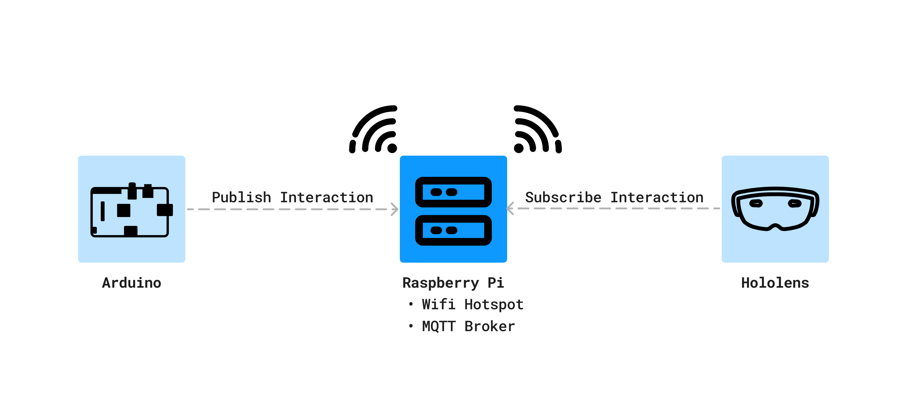
Communication
Publish/Subscribe Model with MQTT
Raspberry Pi as a Communication Hub
Notes:
The communication between our hardware is done via a publish/subscribe model with the MQTT protocol.
To do this, our hardware is in its own Wi-Fi network, which is created by a Raspberry Pi.
The individual messages are sent from our Arduino, which detects the haptic interactions, processes the data and sends it to the Raspberry Pi.
This data is then forwarded to the HoloLens, which changes the displayed city model as a result.

Slide 6
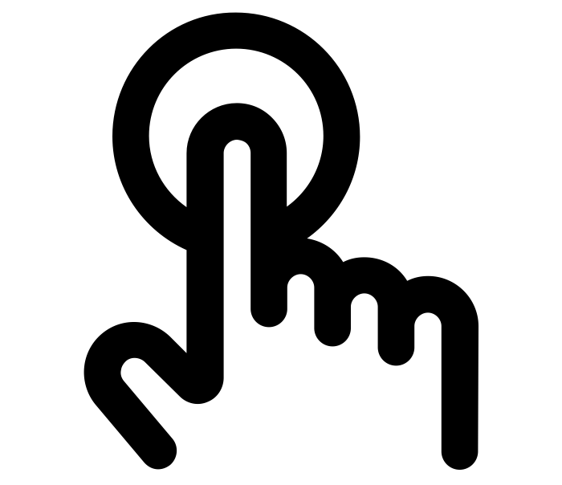
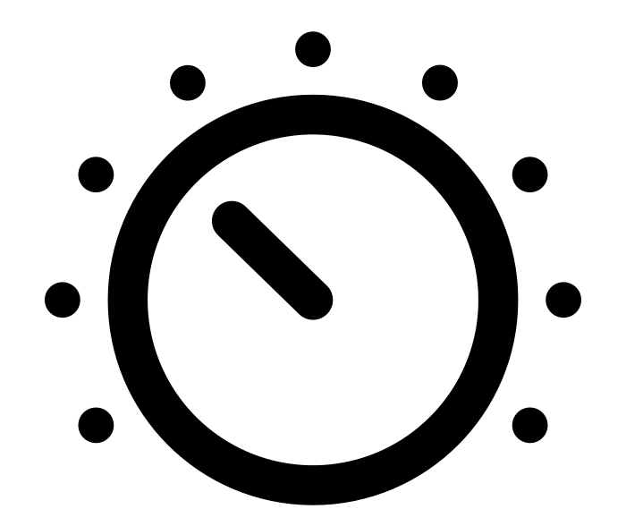
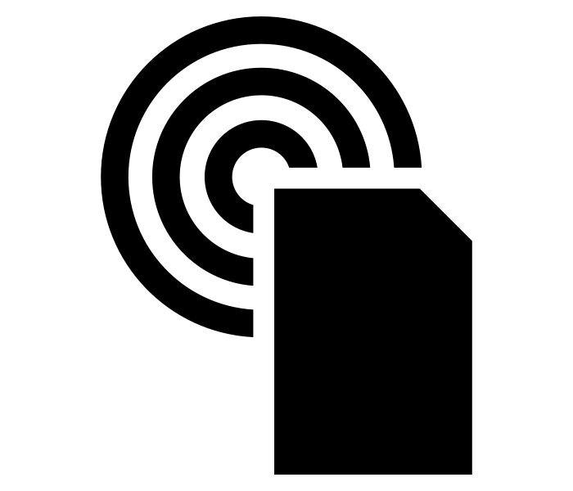
Interactions
Button
Potentiometer
NFC-Reader
Notes:
For the haptic interactions, we opted for a button, a rotary knob and an NFC reader.
All three interactions provide us with different types of data and also change different sectors.
The button can be used to switch the visualization between a current and a new and sustainable steel factory.
The rotary knob determines the energy mix, between 0% and 100% sustainably produced energy,
and the NFC reader can be used to make the residential sector sustainable by replacing a house.

Slide 7
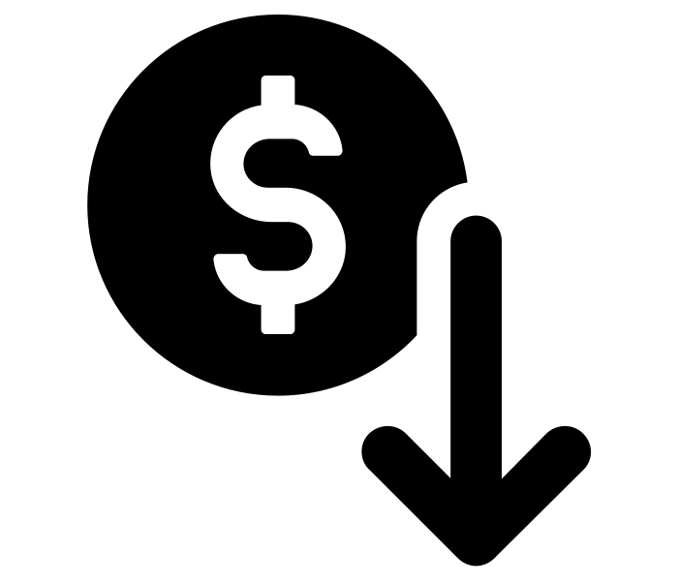
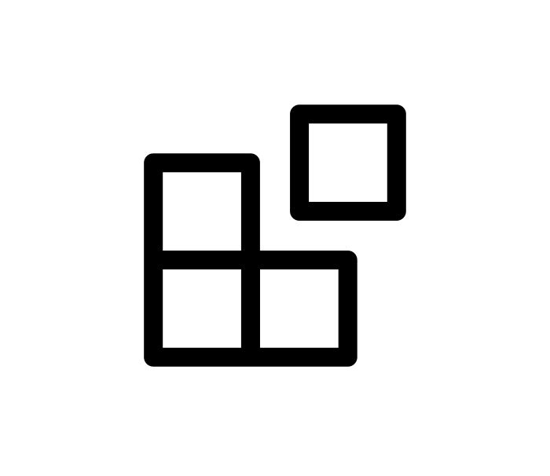
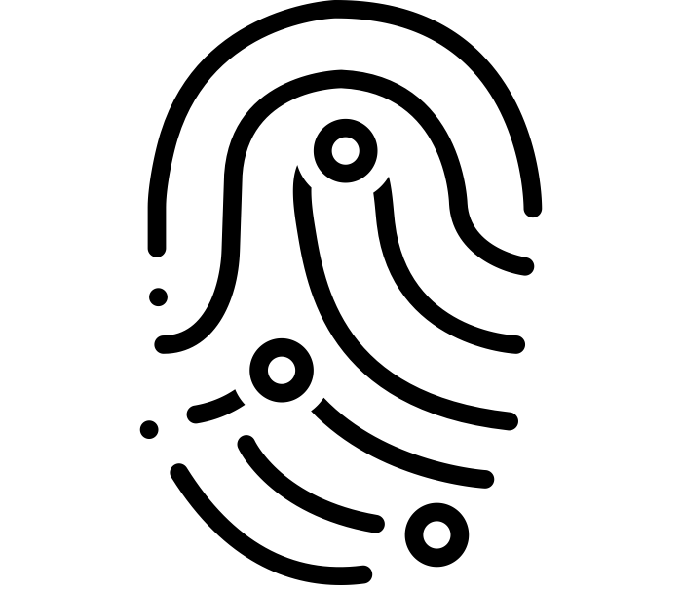
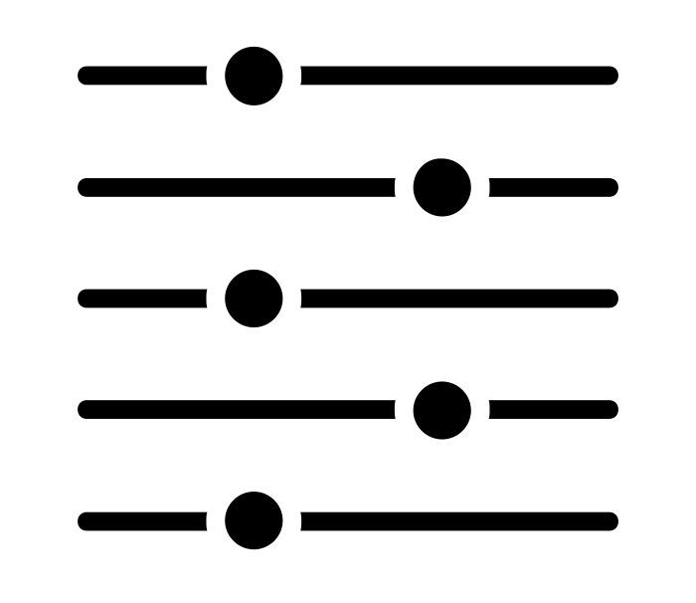
Benefits
Low Budget Implementation
Extendability
Ease of Use
Unique haptic-visual feedback
Notes:
Our implementation not only offers an inexpensive extension of existing AR applications, it can also be expanded.
The system is open for new interactions, which can be integrated easily.
The haptic interactions makes it easier for users to understand the AR application.
Whereas with normal AR apps you press a virtual button, we use physical interactions.
This also gives us a unique visual-haptic experience.

Slide 8
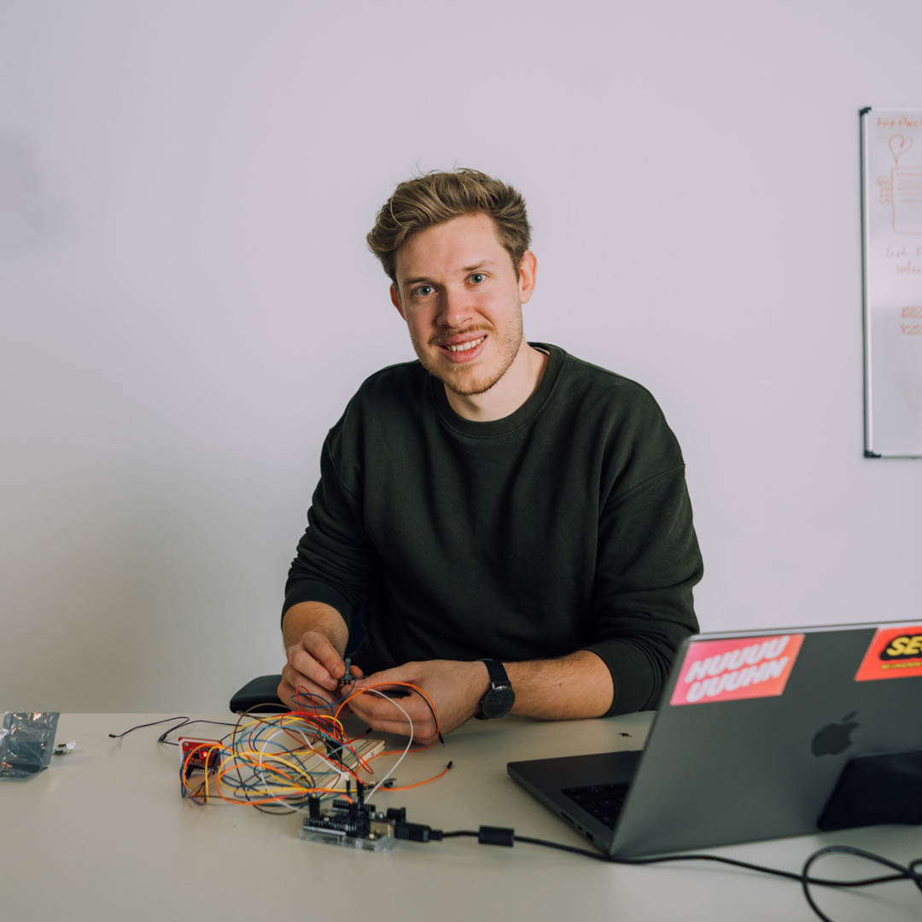
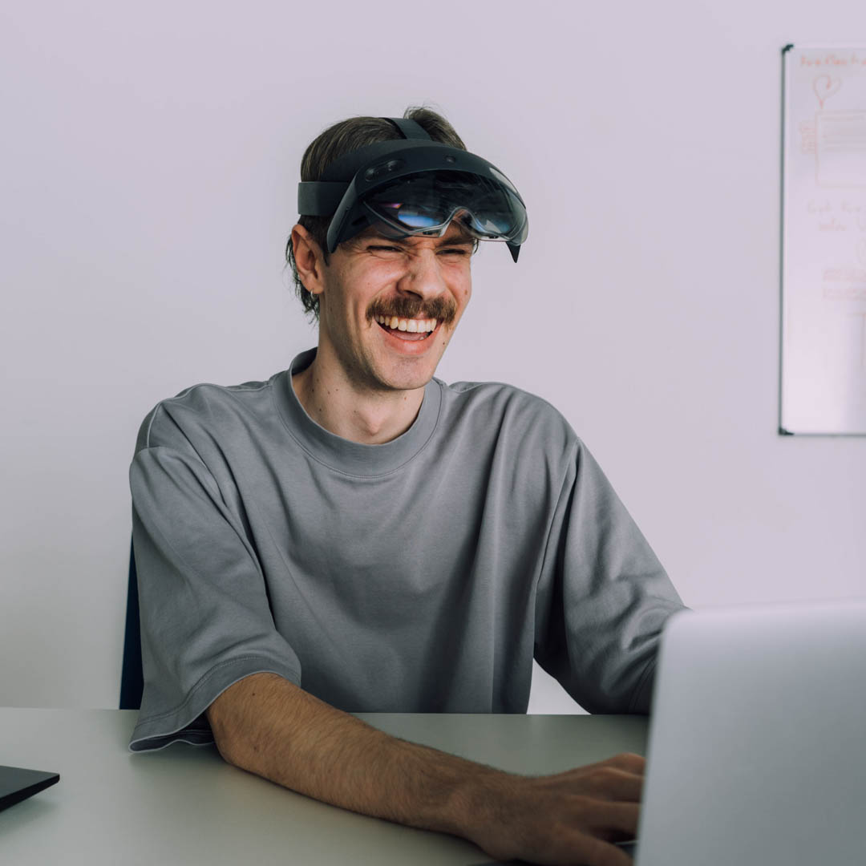
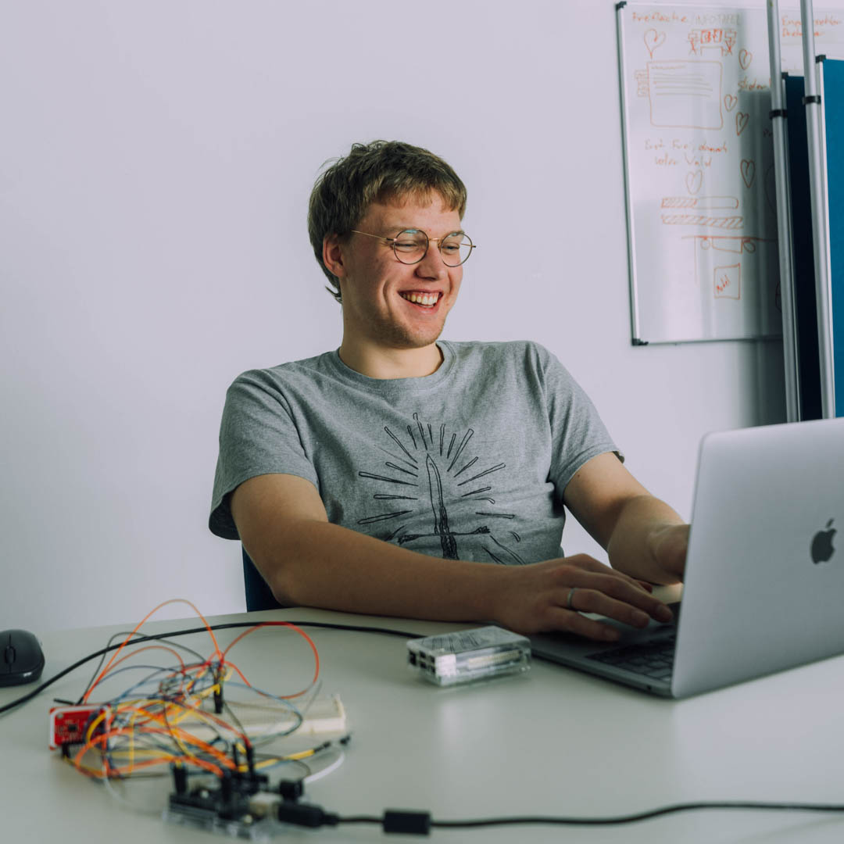
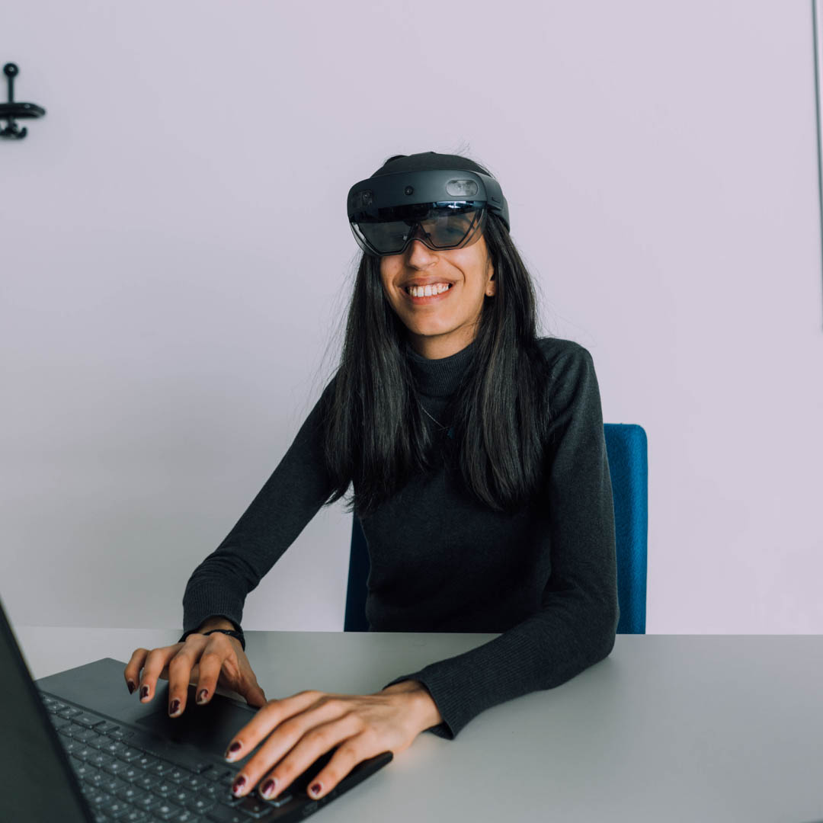
The Team
Chris
Jonas
Timo
Yasmine
- Arduino
- Organisation & Planning
- XR/AR-APP
- Design
- XR/AR-APP & 3D Assets
- Network
- XR/AR-APP
- Communication
Notes:
The project was executed by 4 dedicated IMI students, who were divided as follows:
Jonas took care of the AR app and the design,
Timo was responsible for the AR app, the 3D assets and the network.
Yasmine took care of the AR app and the network communication
I was responsible for the haptic interaction and the organization.

Slide 9
Digital-haptic city model for information transfer using XR/AR
Notes:
If you want to hear more about our work or if you want to see how you can make a city more sustainable, then come and visit us at our booth.
We are right next to the entrance on the left.

